Slide 1
Predicting diabetes
Sami Chowdhury, Yiannis Pagkalos, Lauren Christiansen, Mei Kam Bharadwaj , Dhwani Patel

Slide 2
Table of contents
01
02
03
Executive Summary
Goals and Questions
Data Collection and Cleanup
04
05
06
Approach/Issues and Resolution
Results/ Conclusion
Potential Next Steps
Notes:
Approach:

Slide 3
Executive Summary
Our project goal was to determine how key datapoints (BMI, high blood pressure, cholesterol, stroke, heart disease/attack, physical activity level, general health level, physical health level, difficulty walking scale, age, education level, income level) relate to the diagnosis of diabetes in different patients.
We used this underlying data to create and train machine learning models to easily predict whether a patient would be diagnosed.

Slide 4
goals/ questions
Our aim was to identify and utilize the most impactful datapoints (e.g., BMI, blood pressure, cholesterol, lifestyle factors) to improve our model’s accuracy and reliability on predicting a diabetes diagnosis.
Questions:
Which dataset is best to train our model (number of features, rows and quality)?
Which features are most strongly correlated to diabetes diagnoses, and how do they contribute to the model's predictions?
What are the models that will produce the best accuracy scores?
How can we finetune the selected models to amplify accuracy scores?

Slide 5
DAta Collection / CLean up
Collected at the following Kaggle link by Alex Teboul
Obtained from the Behavioral Risk Factor Surveillance System (BRFSS), an annual telephone survey that is collected annually by the CDC.
The features are either questions asked of participants or variables calculated based on their responses. The dataset includes the following:
['Diabetes_binary', 'HighBP', 'HighChol', 'CholCheck', 'BMI', 'Smoker', 'Stroke', 'HeartDiseaseorAttack', 'PhysActivity', 'Fruits', 'Veggies', 'HvyAlcoholConsump', 'AnyHealthcare', 'NoDocbcCost', 'GenHlth', 'MentHlth', 'PhysHlth', 'DiffWalk', 'Sex', 'Age', 'Education', 'Income']

Slide 6
Approach
Data was already balanced, cleaned for nulls (Kaggle included both balanced and unbalanced versions of the data)
Required encoding of a few set features (BMI condensed to scientific classifications from Underweight to Obesity 3, and initially also encoded AGE, INCOME, EDUCATION)
In the end, we only encoded BMI and kept the original groupings of AGE, INCOME, and EDUCATION as this ended up producing better results
Initially we did not remove features that were not strongly correlated to the results. Eventually removing those improved our model performance.
Data was scaled since we had many ordinal encoders, all categorical and ordered
Finally, we run GridSearchCV for all the models to further optimize performance by identifying model parameters that could help

Slide 7
Results and Conclusions
Given the nonlinear classification of the data, we experimented with the following models below. After all optimizations the following results were achieved:
Decision Tree: 74.5%
KNeighborsClassifier: 73.9%
Logistic Regression: 75.2%
RandomForestClassifier: 75.4%
XGBClassifier: 75.6%

Slide 8
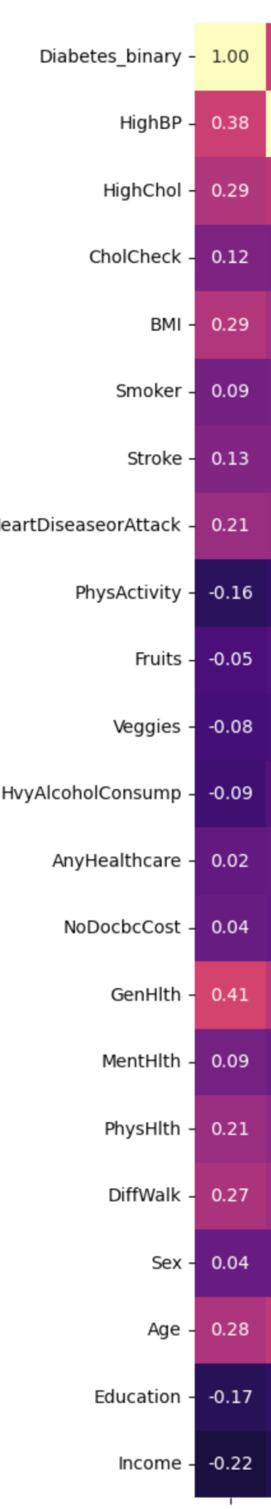
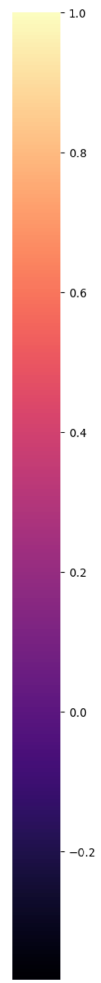
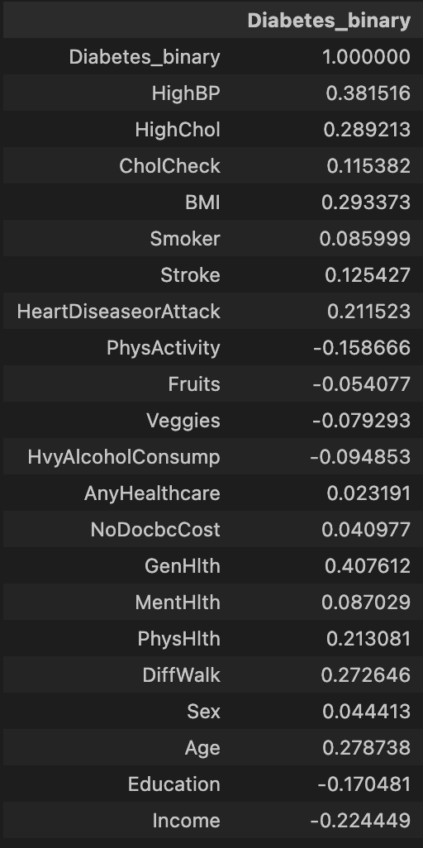
Data Correlation Matrix

Slide 9
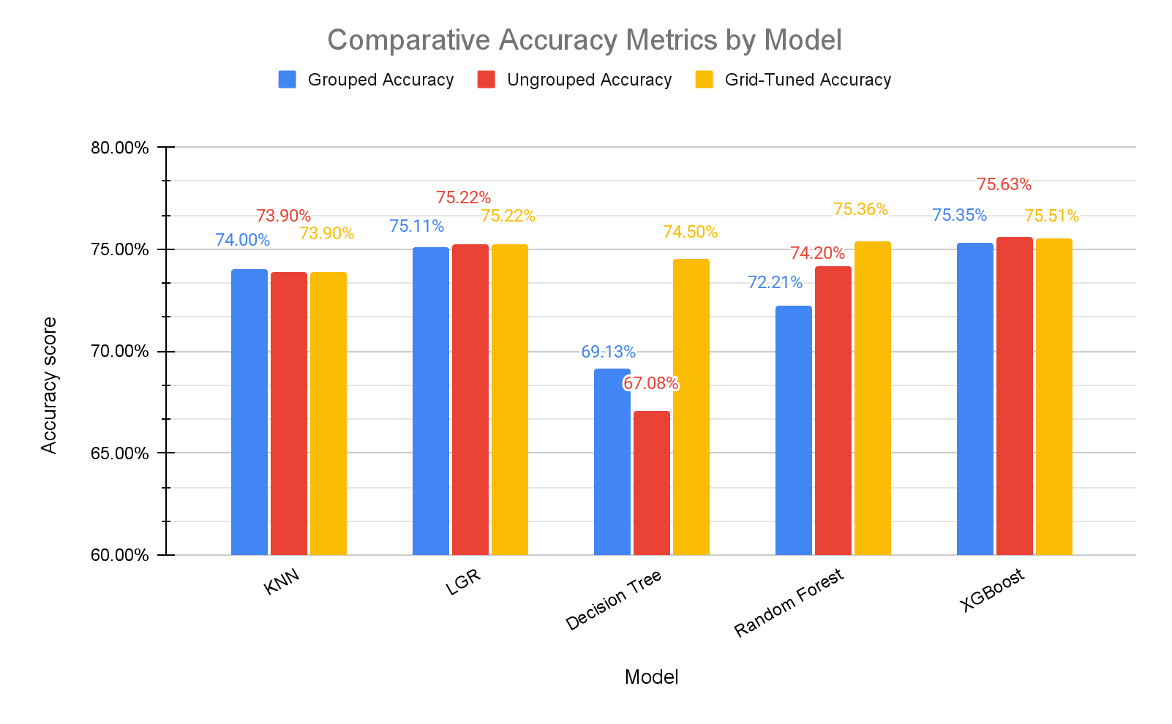
Results and Conclusions
The biggest improvements were achieved in the Decision Tree and the Random Forest model after the GridSearch optimization
Interestingly, KNN and LGR models performed slightly worse after we ungrouped the Age, Education and Income categories.
Similarly, XBoost performed better before GridSearch but only marginally.

Slide 10
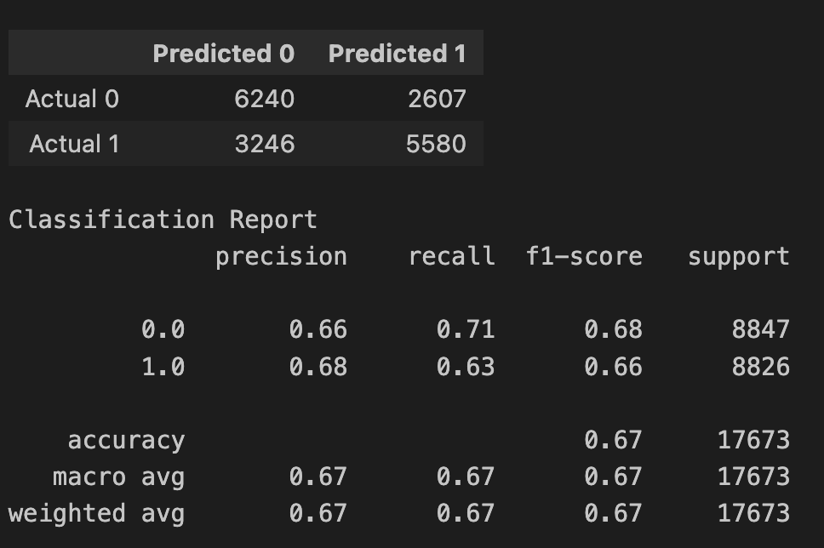
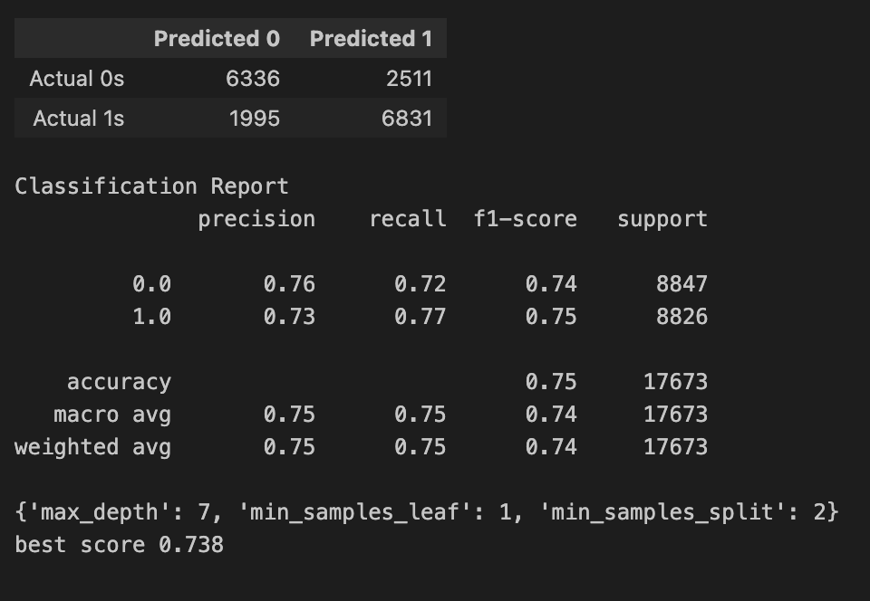
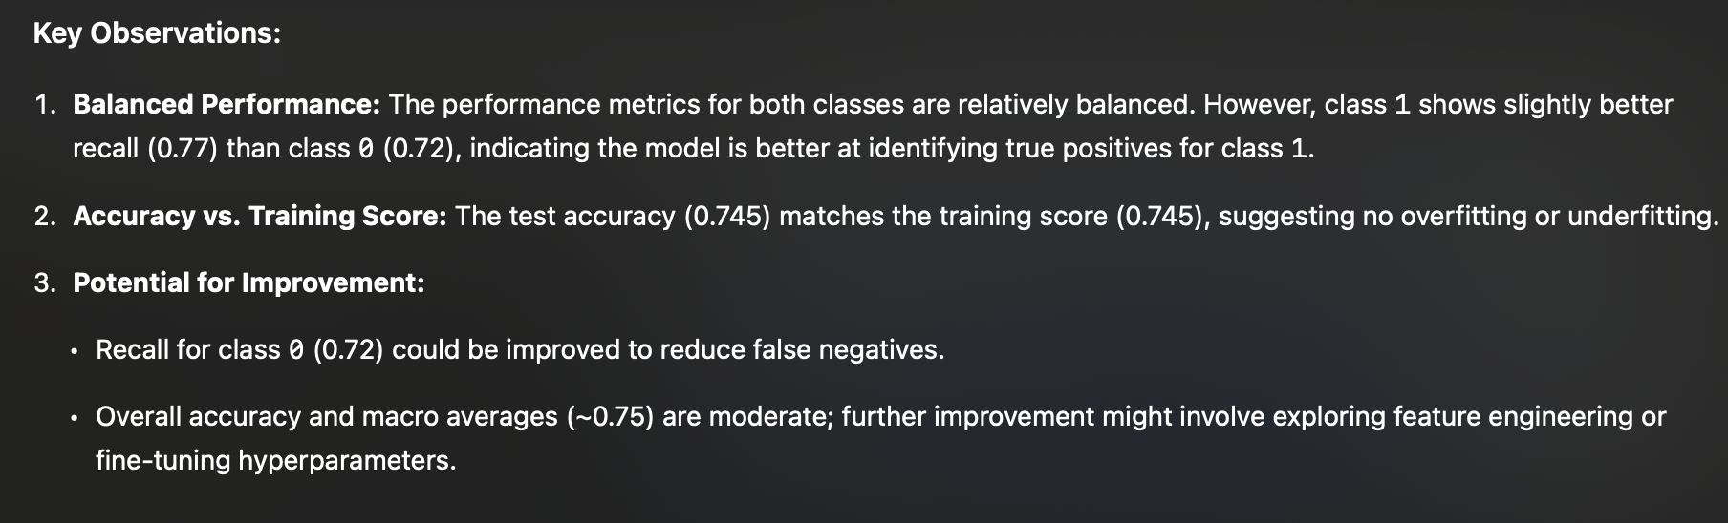
Decision Tree
GridSearchCV
Accuracy: 0.67
Test score: 0.67
Train Score: 0.93
Accuracy: 0.745
Test score: 0.745
Train Score: 0.745
No parameters specified
Notes:
The formula is: Recall = True Positives / (True Positives + False Negatives)
F1-score is the harmonic mean of precision and recall, providing a single score that balances both metrics. It's particularly useful when you have an uneven class distribution.
The F1-score ranges from 0 to 1, where:
1 represents perfect precision and recall
0 represents the worst case
Support simply shows how many samples of each class were in the test dataset. It's not a performance metric but rather provides context about the class distribution. This is crucial because:
It helps identify class imbalance
It gives you an idea of how much data the other metrics are based on
Low support numbers might indicate that the metrics for that class are less reliable
Precision measures the accuracy of positive predictions - it answers the question "Of all the cases we predicted as positive, how many were actually positive?"
The formula is: Precision = True Positives / (True Positives + False Positives)
Let me use a concrete example of a spam email detector:
If our model flags 100 emails as spam
But only 80 of those were actually spam (true positives)
And 20 were legitimate emails incorrectly flagged (false positives)
Then precision would be 80/100 = 0.80 or 80%
The key difference between precision and recall:
Precision focuses on the accuracy of positive predictions (how many of our spam predictions were correct)
Recall focuses on coverage of actual positives (how many actual spam emails we caught)
A model with high precision but low recall would:
Be very careful about labeling something as spam
Rarely make false accusations
But might miss many actual spam emails
A model with high recall but low precision would:
Catch most actual spam emails
But also incorrectly flag many legitimate emails as spam
This is why the F1-score, which balances both metrics, is often used as an overall performance measure.

Slide 11
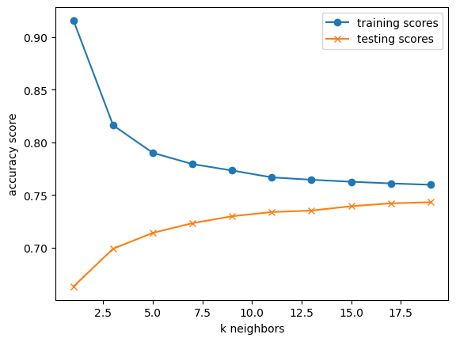
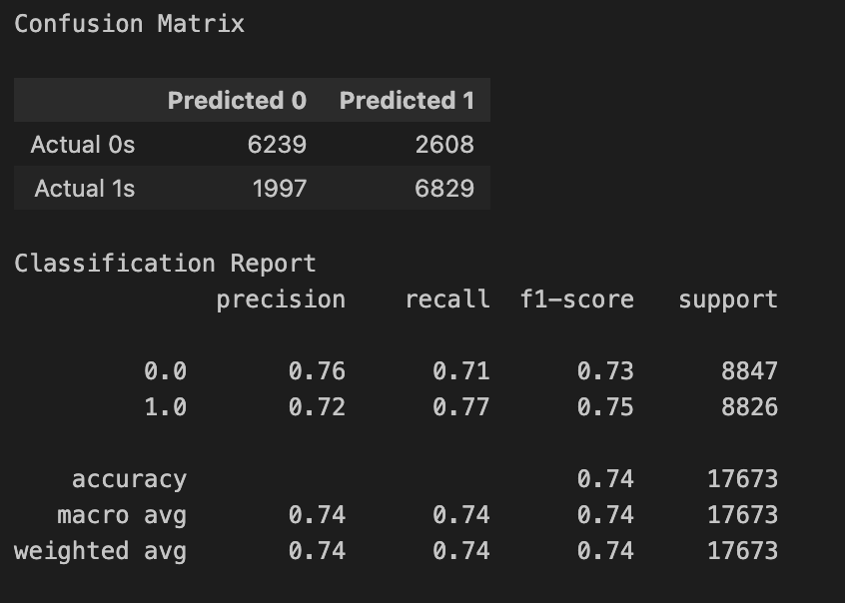
KNN model
Accuracy: 0.739
Test score: 0.739
Train Score: 0.763
Training and Test scores converged as k increased
k=15 seems the best choice for this dataset
For k=15 accuracy= 73.9%

Slide 12
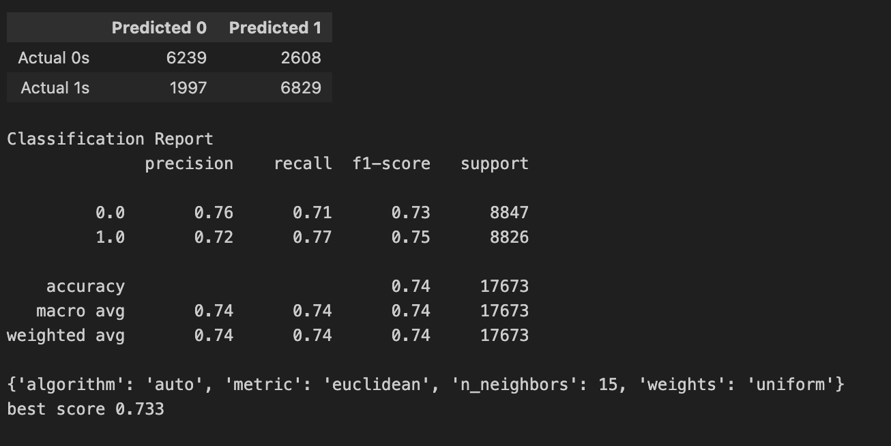
KNN model
GridSearchCV
Accuracy: 0.739
Test score: 0.739
Train Score: 0.763

Slide 13
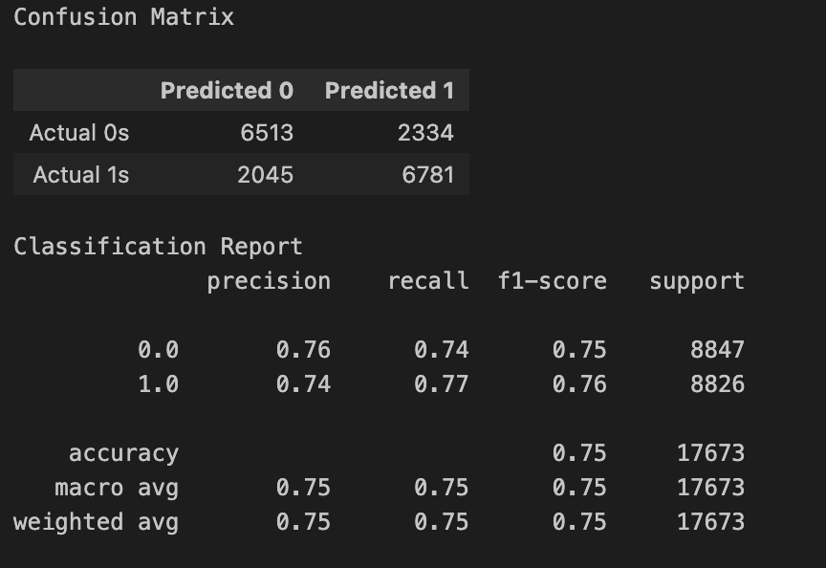
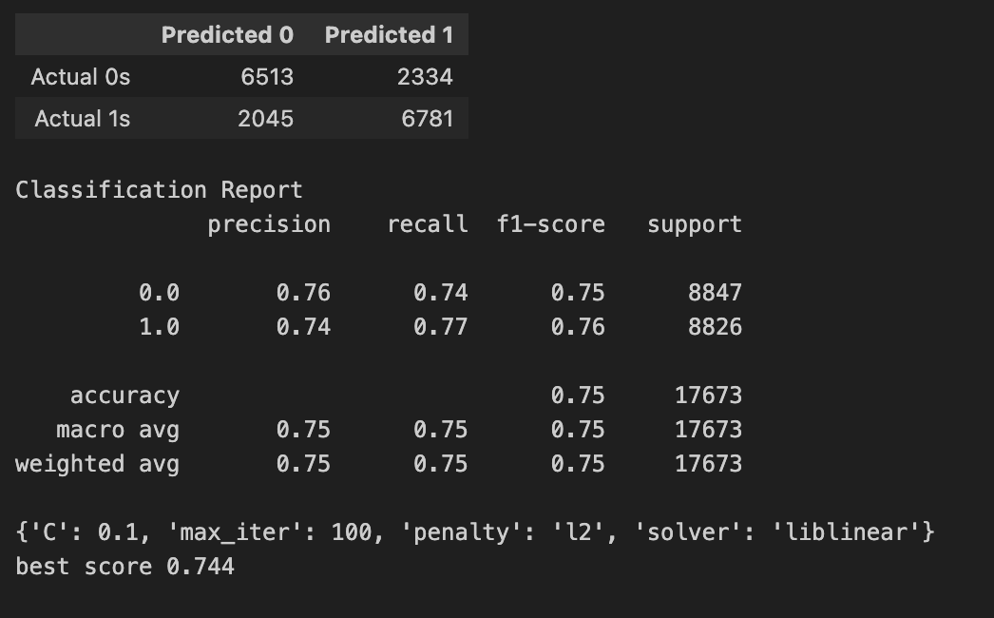
Logistic regression
GridSearchCV
Accuracy: 0.752
Test score: 0.752
Train Score: 0.745
Accuracy: 0.752
Test score: 0.752
Train Score: 0.745
random_state=1, max_iter=100
The model performs similarly for both classes, with a slight edge in recall for class 1.
Precision and recall are balanced, as reflected in the F1-scores for both classes.
The accuracy (75.2%) shows the model is moderately good but could be improved, especially for imbalanced errors like reducing false positives/negatives.
The consistency between the training score (74.5%) and test score (75.2%) suggests the model generalizes well and avoids overfitting.

Slide 14
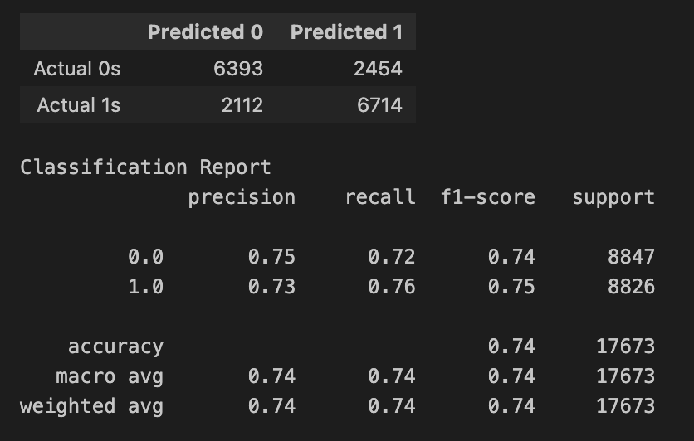
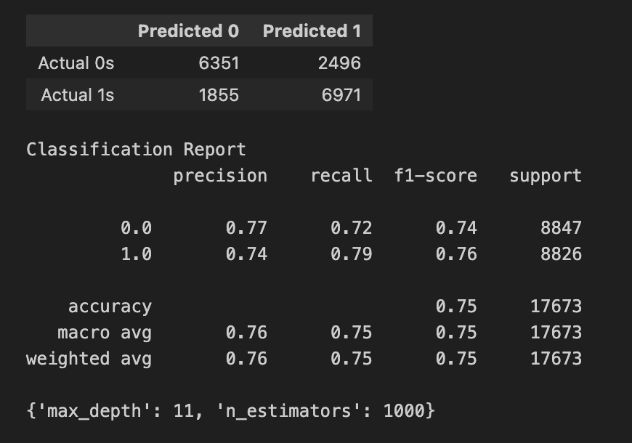
Random Forest
GridSearchCV
Accuracy: 0.742
Test score: 0.742
Train Score: 0.735
Accuracy: 0.754
Test score: 0.754
Train Score: 0.776
random_state=1, n_estimators=500, max_depth=3
Class 1 (Positive) Performance: Recall (0.79) is higher than precision (0.74), indicating the model is better at identifying true positives but has a moderate number of false positives.
Class 0 (Negative) Performance: Precision (0.77) is higher than recall (0.72), meaning the model predicts negatives more cautiously but misses some actual negatives.
The train score (0.776) is slightly higher than the test score (0.754), which may indicate slight overfitting but nothing significant.

Slide 15
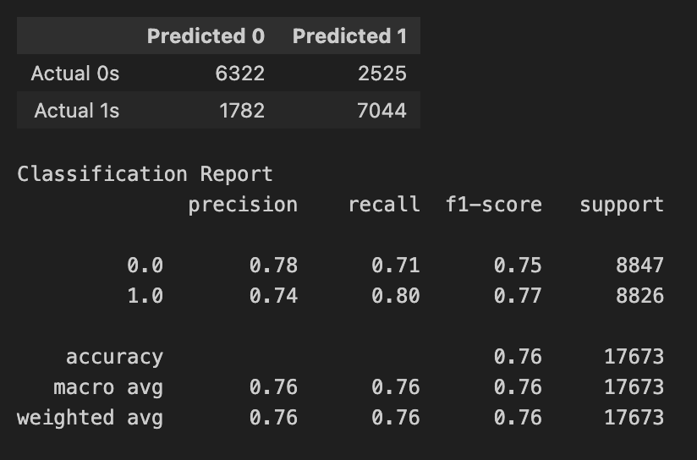
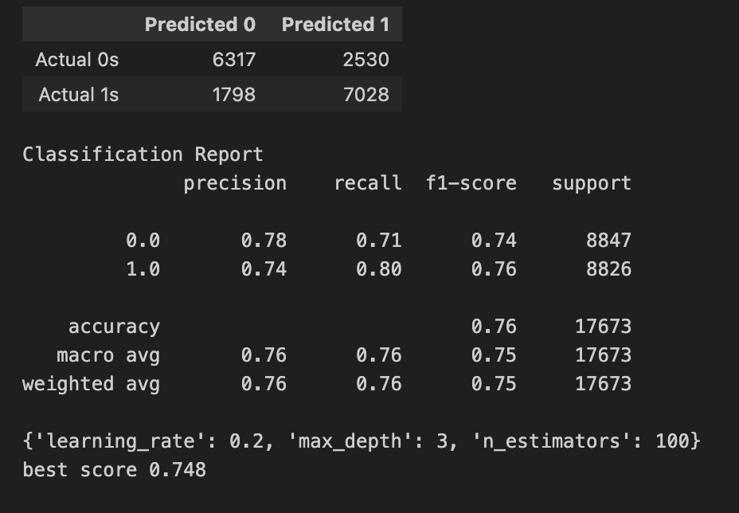
xgboost
GridSearchCV
Accuracy: 0.756
Test score: 0.756
Train Score: 0.754
Accuracy: 0.755
Test score: 0.755
Train Score: 0.752
xgb_model = XGBClassifier(random_state=1, learning_rate=0.05, n_estimators=1000, max_depth=3)
Class 1 (Positive) Performance: Higher recall (0.80) than precision (0.74), meaning the model is better at identifying positive cases but has more false positives.
Class 0 (Negative) Performance: Higher precision (0.78) than recall (0.71), indicating the model is better at predicting 0s when it does, but misses some actual 0s.
The train and test scores are close (Train: 0.754, Test: 0.756), indicating the model generalizes well and is not overfitting.

Slide 16
Potential next steps
We could explore more datasets that include health indicators such as HbA1C (hemoglobin A1C) and fast blood sugar test (FBS).
HbA1C test measures the average blood sugar (glucose) level over the past 60-90 days. A fasting blood sugar test measures the blood sugar levels first thing in the morning before the patient breaks their fast.
If the patient’s blood sugar is high, then it indicates that patient has difficulties breaking down sugar in their body.
It is best to look at a dataset that includes both HbA1C and FBS data. HbA1C tests are less sensitive compared to the FBS test, but provides a more comprehensive story on the patient’s blood sugar over a period of months.
In practice, both tests are used in the office to get a more accurate diagnosis of diabetes.
We could experiment with more models and/or model parameter tuning

Slide 17
Thank you!

Slide 18
Appendix

Slide 19
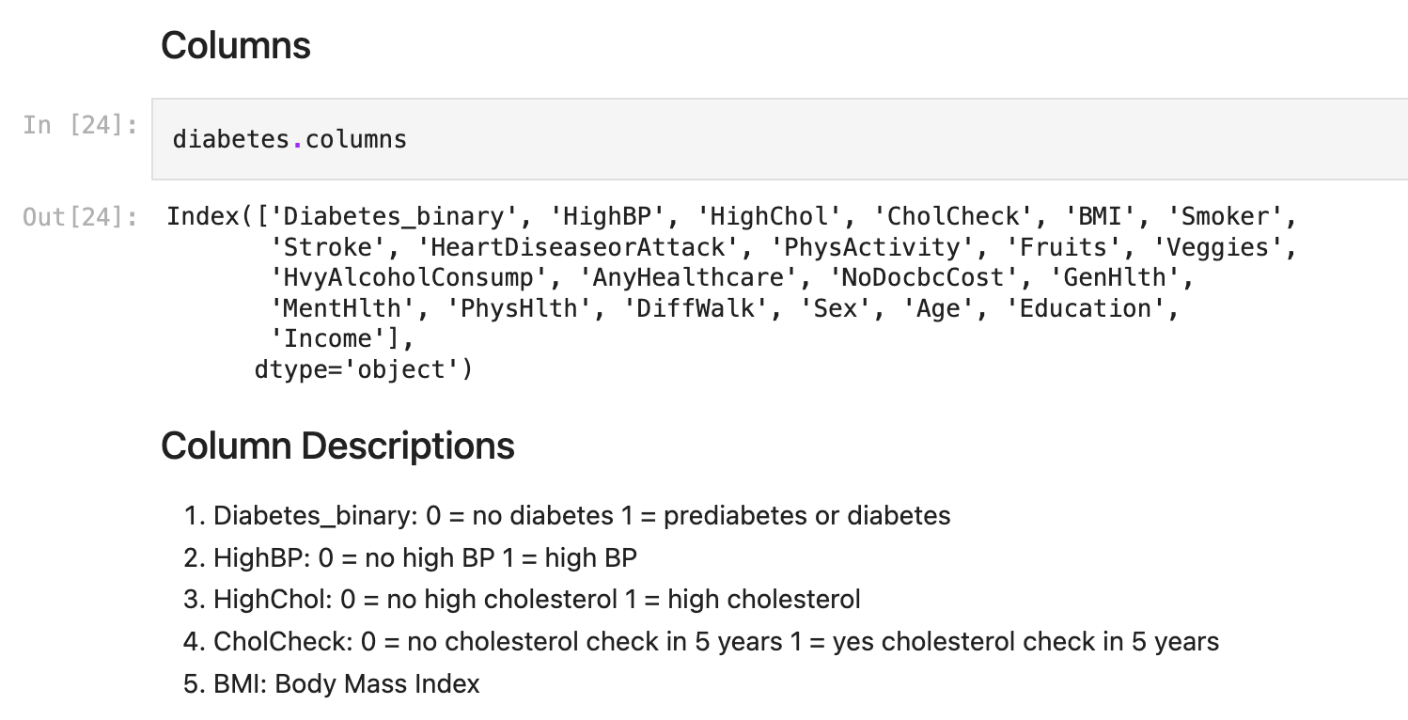
Columns / column descriptions

Slide 20
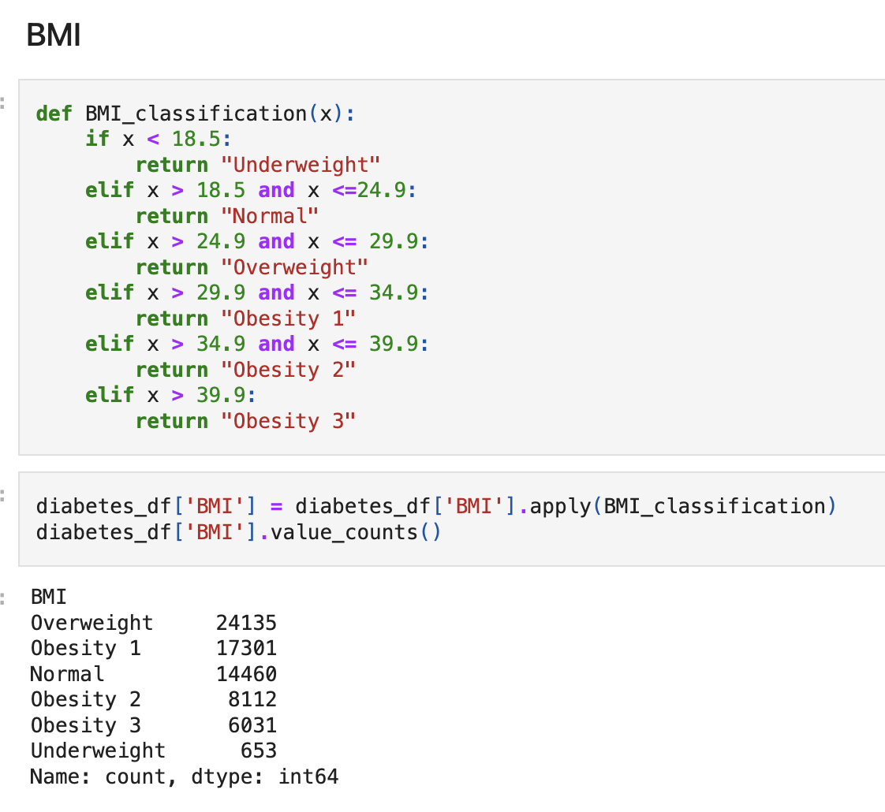
BMI classification

